Slide 1
On the journey of life….
....we are glad to be together as a school community.
Notes:
Slide 1: Use these gathering words for this term, or your usual greeting if you prefer.

Slide 2
As we gather today….
....may we learn from each other and hear from God.
Notes:
Slide 2: Use these gathering words for this term, or your usual greeting if you prefer.

Slide 3
How far back….?
Notes:
Slide 3: Can you remember….?! See how far back in time you can collectively remember things that have happened at school. [NB EYFS children may not be able to do this!]

Slide 4
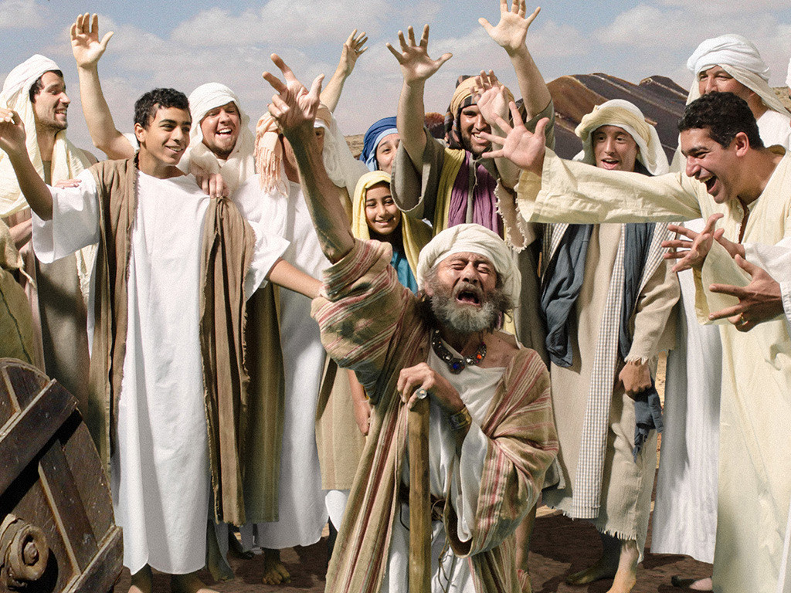
Joseph: A Family Saga
Autumn 2022
Notes:
Slide 4: You might recall that this time last year, we were beginning Joseph’s family saga, when we followed him to Egypt and saw how God was with him through all of the ups and downs of his life.

Slide 5
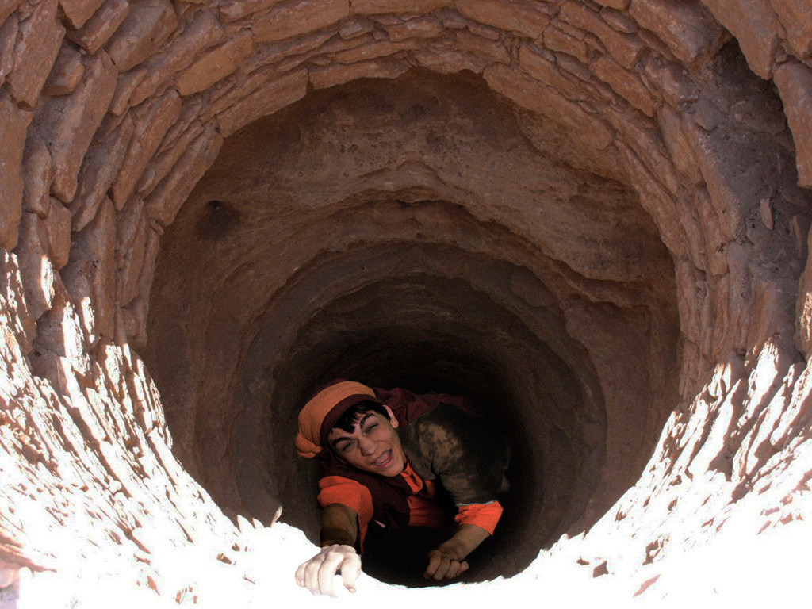
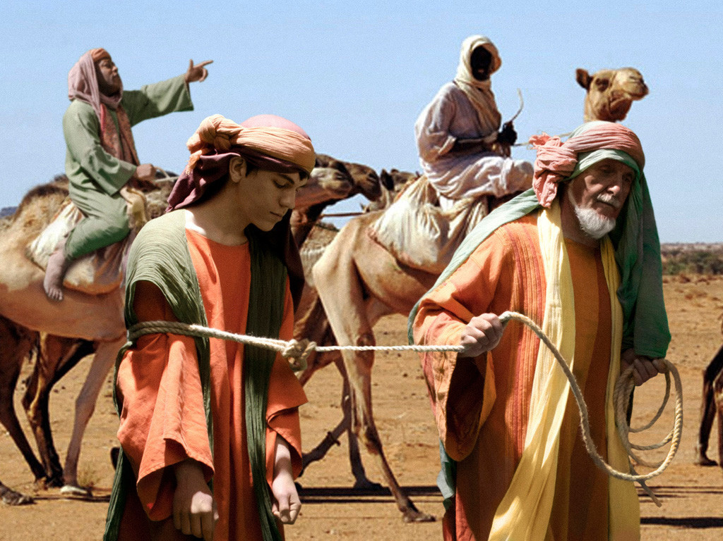
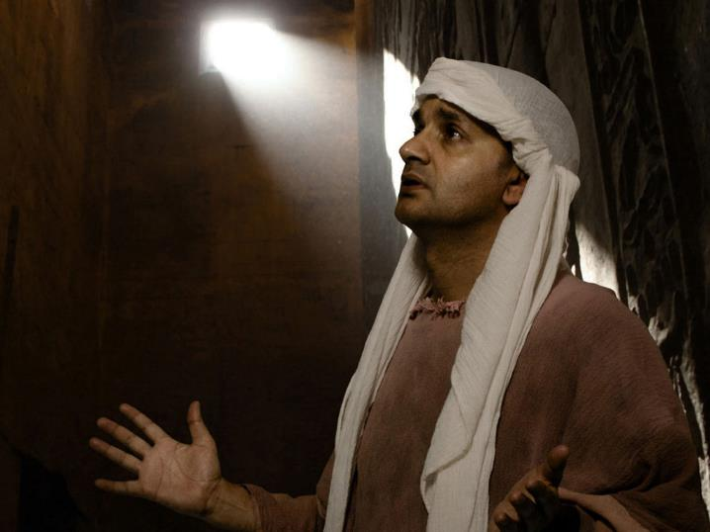
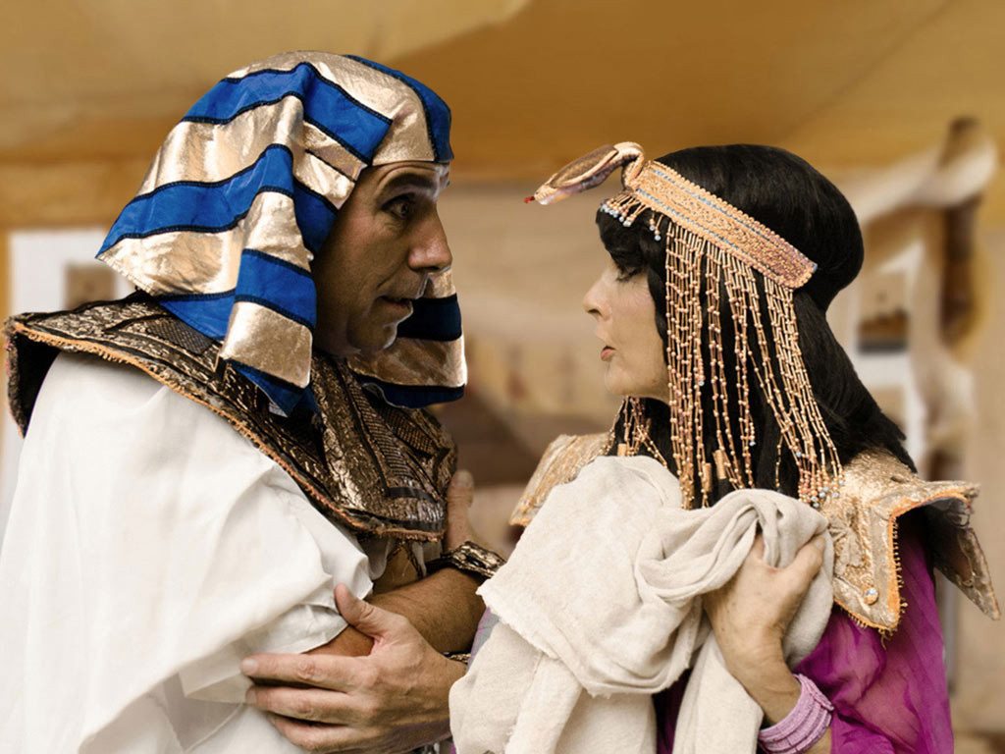
Notes:
Slide 5: …remember these?!
How his brothers dropped him down a well….
….but he was rescued by traders who sold him to Potiphar
…whose wife got him into trouble…
….which landed him in prison?

Slide 6
Notes:
Slide 6: ….but then because God was with him and helped him to understand what Pharoah’s strange dreams meant, he became the second most important person in Egypt, next to Pharoah – and saved his whole family from starving in the great famine.

Slide 7
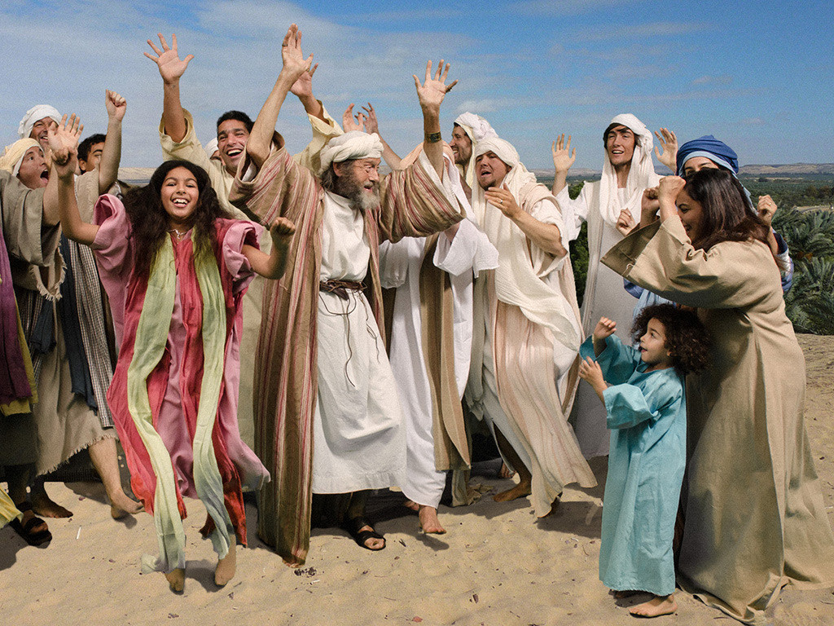
Notes:
Slide 7: ….Well, Joseph lived to be a very old man – long enough to meet his great-great grandchildren! As you may remember, he and his family had made their home in Egypt.
Before he died, he told his brothers that one day, they would be able to go back to the Promised Land, the home that God had promised Abraham.

Slide 8
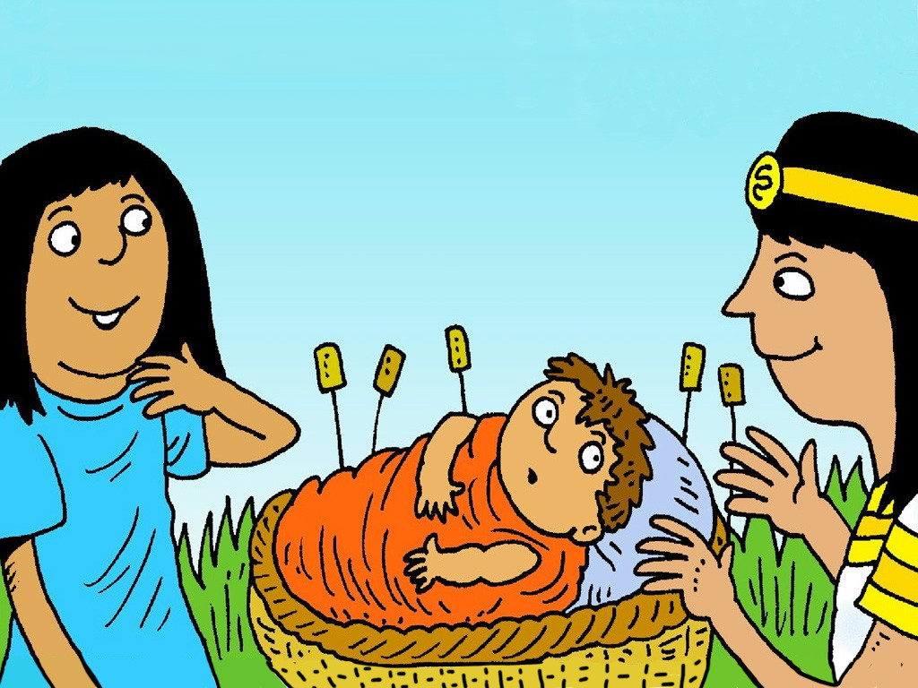
Moses: Are we nearly there yet?!
Autumn 2023
Notes:
Slide 8: Well, we are going to skip forward about three hundred years now, and begin another saga that will take us from this week until the start of Advent. We’re calling it ‘Are we nearly there yet?!’ (which I expect some of you have said when you’ve been travelling on a journey!!) because a lot of the story happens on a great big journey.
But let’s begin where all stories start – at the very beginning, with God’s people living in Egypt!

Slide 9
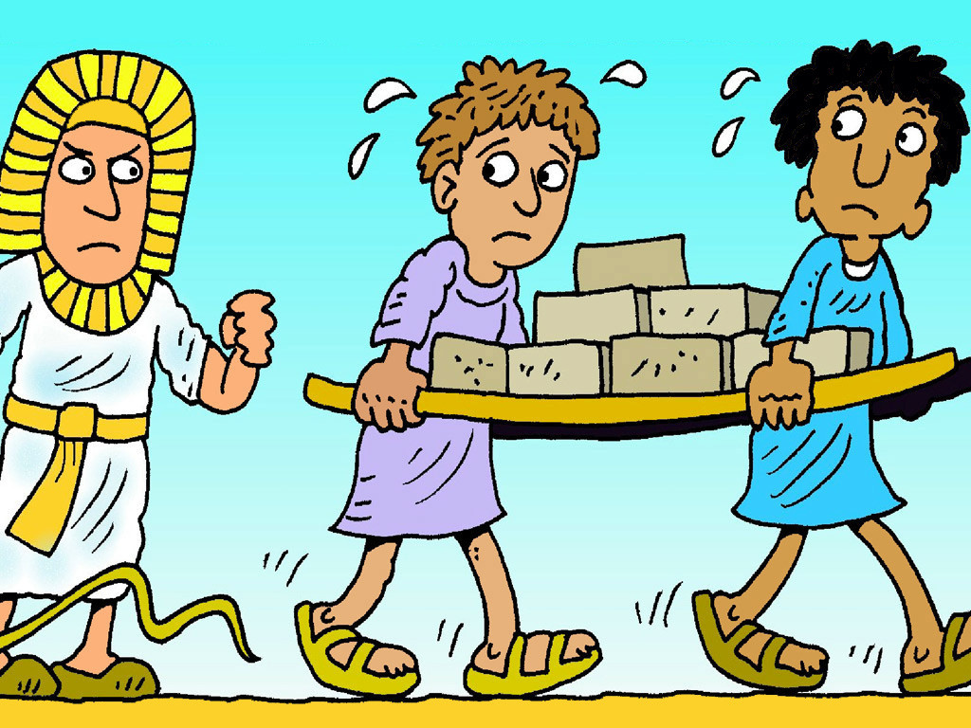
Notes:
Slide 9: Time went by and the people of God grew in number. Such a large number of people that the new Pharoah looked at them all and began to worry.
‘There are too many Israelites! They will join with our enemies and overcome us. We must make them slaves and make them build us new cities. I will take away all the baby boys before they are stronger than me.’
One of those baby boys was a tiny baby called Moses.

Slide 10
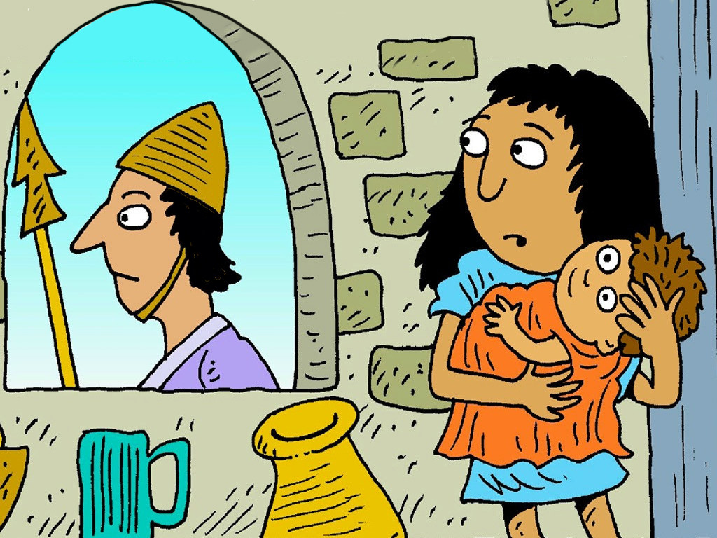
Notes:
Slide 10: Moses had a very clever big sister. She looked out of her window. When the soldiers came the family hid the baby and prayed that God would keep him safe.

Slide 11
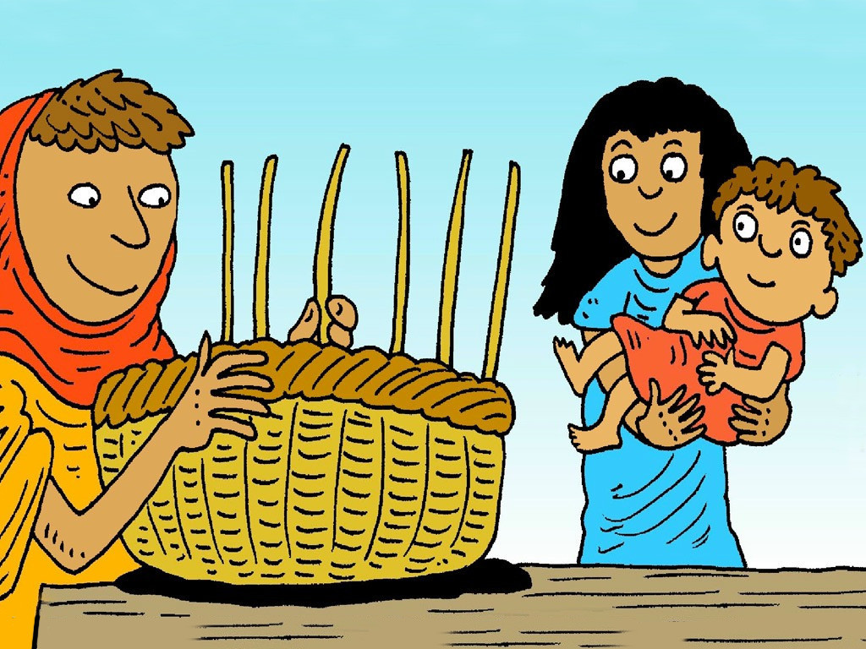
Notes:
Slide 11: Soon their baby was too big to hide. His mother made a special little bed, in a basket, to float the baby down the river Nile, to a safe place. ‘God will look after him,’ she said.

Slide 12
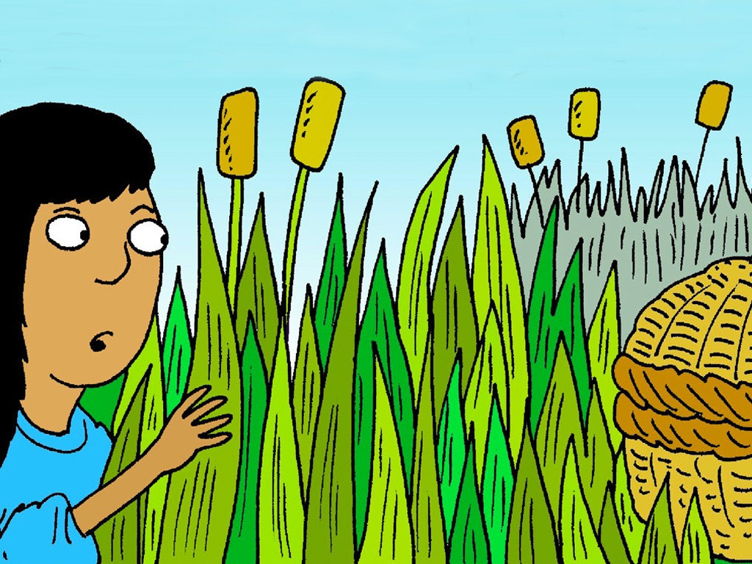
Notes:
Slide 12: She tucked him in the bed and he fell fast asleep. ‘God keep our baby safe,’ she prayed. Miriam, his sister, watched nearby. Then the baby began to cry.

Slide 13
Notes:
Slide 13: Miriam saw a Princess come down to the river. The Princess found the baby and she loved him. ‘I will call him Moses,’ she said, ‘but I need someone to help me look after him.’

Slide 14
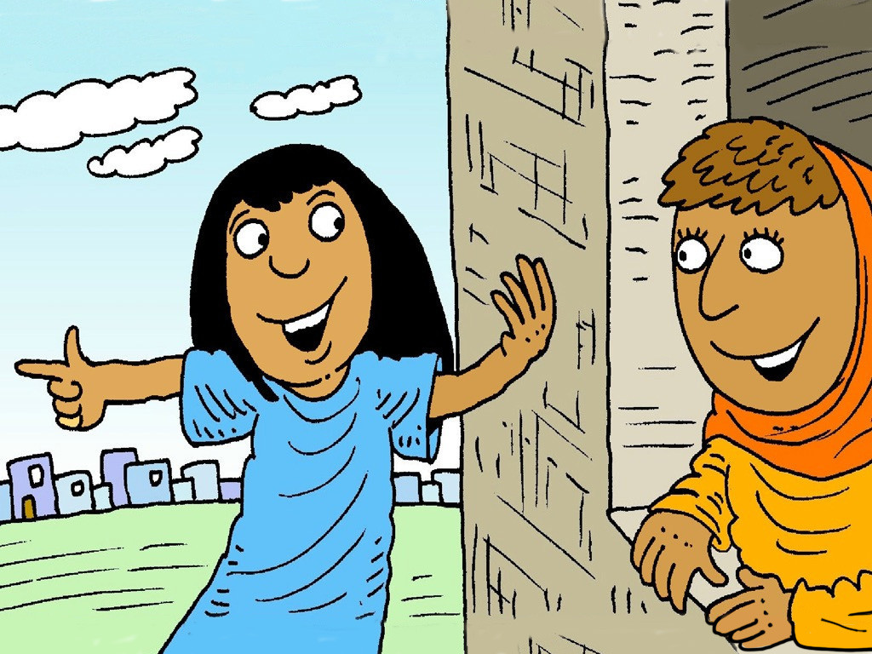
Notes:
Slide 14: The Princess saw Miriam and sent her to find a lady to feed the hungry baby. Miriam ran home to get her mother and said, ‘The Princess needs you to look after the baby!’

Slide 15
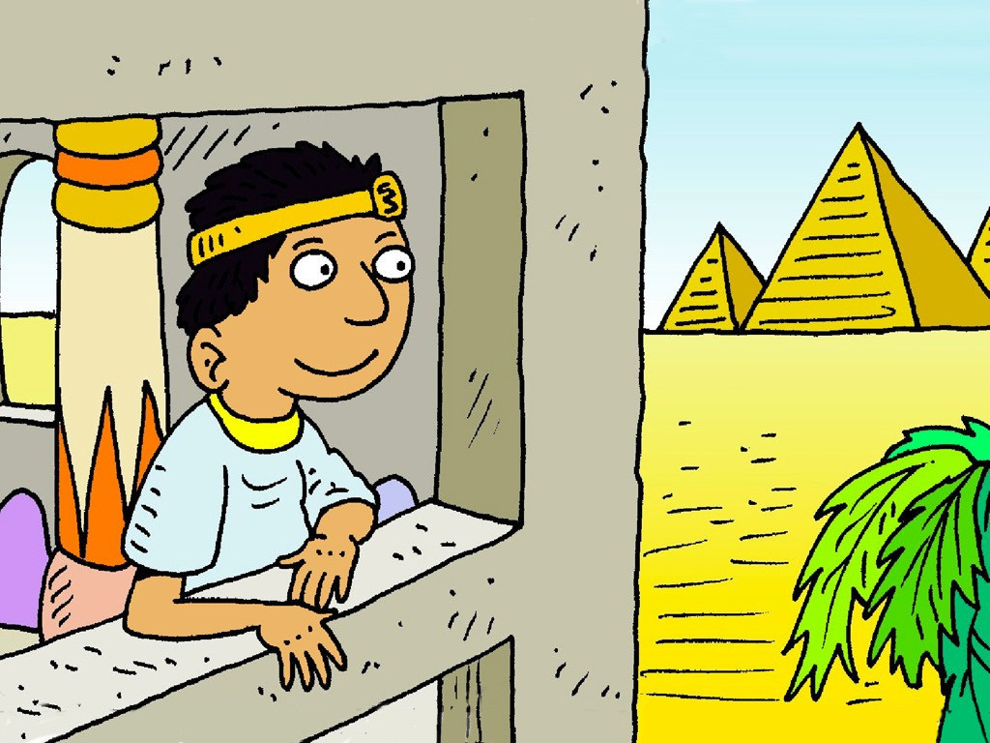
Notes:
Slide 15: When he was bigger Moses went to live with the Princess, in King Pharaoh's Palace. Moses always loved God with all his heart and knew that God had kept him safe. Just as God had had a plan for Joseph’s life, he had an even bigger plan for Moses.
But what other adventures would lie ahead, and where would they take him?.....[add your own cliffhanger sound effects here!!!]

Slide 16
Moses: Are we nearly there yet?!
Autumn 2023
Notes:
Slide 16: This term, we are going to journey with Moses wherever God takes him. He is an important character in God’s big story and would become one of the greatest leaders of God’s people. The journey that God’s people go on in this story shapes the whole community, as they learn to trust God and follow Moses.
As we journey together, we are going to use the story of Moses to help us to become a stronger community.

Slide 17
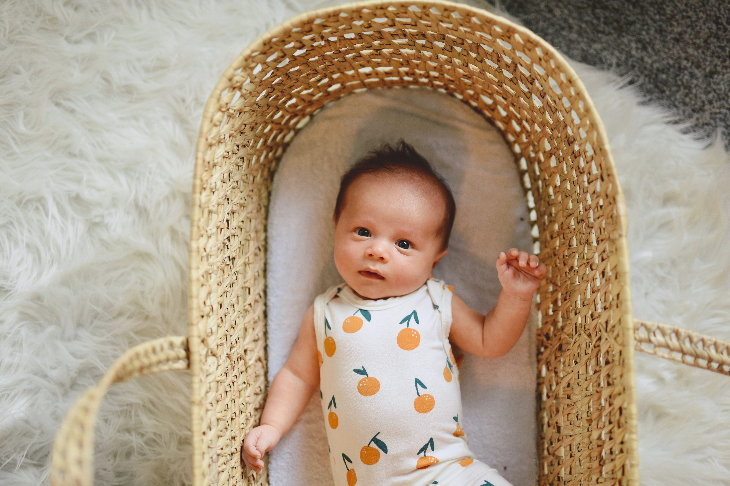
Notes:
Slide 17: You might have had one of these when you were just a tiny baby. It’s called a Moses basket – which comes straight from this story about God keeping Moses safe.
It’s a special basket for keeping babies safe when they are too tiny to sleep in a big cot or bed.
We’re going to pause now to think about being safe.
Close your eyes and imagine the safest place possible….[Pause for quiet thought, for as long as you can]

Slide 18
….I wonder why God chose Moses and kept him safe?....
….I wonder what you think his sister and his mother learned about God’s care for their family?....
….I wonder who you might want to be kept safe on the journey of life?.....
Notes:
Slide 18: Let’s be still and quiet together for a few moments now…..
Moses was kept safe in his basket.
I wonder…..
….why God chose Moses and kept him safe?....
….what you think his sister and his mother learned about God’s care for their family?....
….who you might want to be kept safe on the journey of life?.....
…bring these people into your mind now and hold them there.

Slide 19
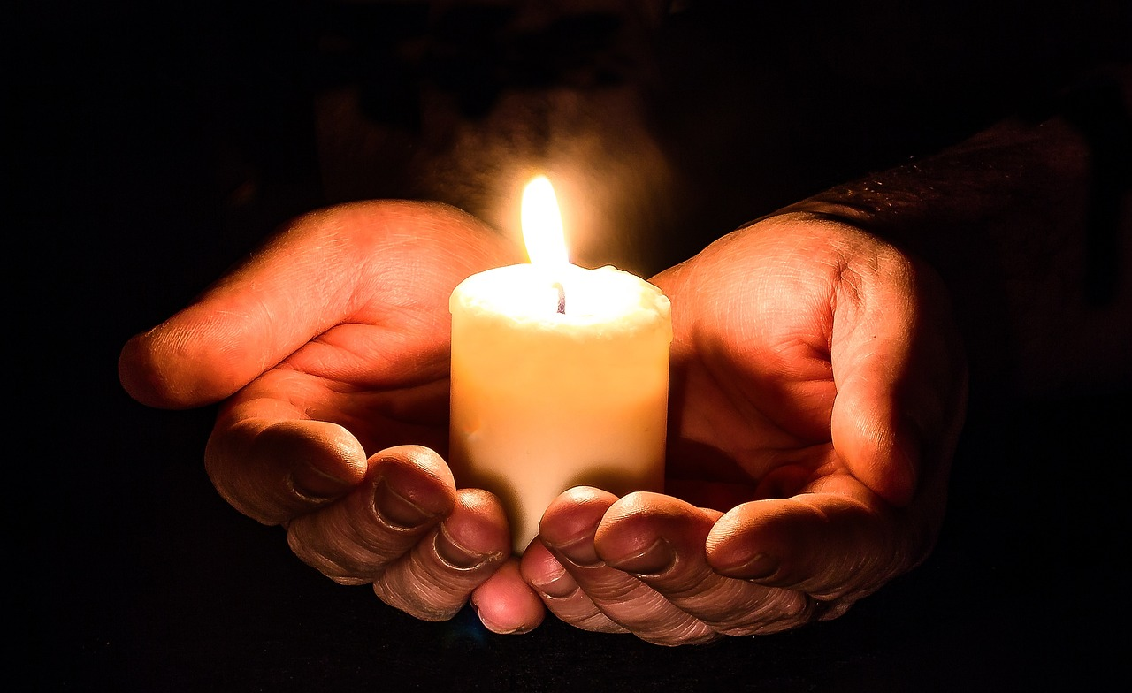
God,
please go with us.
Notes:
Slide 19: I’m going to pray now. After I say God’s name, ‘God’ you might want to join in with ‘please go with us’.
If you don’t want to pray, then use the quiet to be still with your own thoughts.

Slide 20
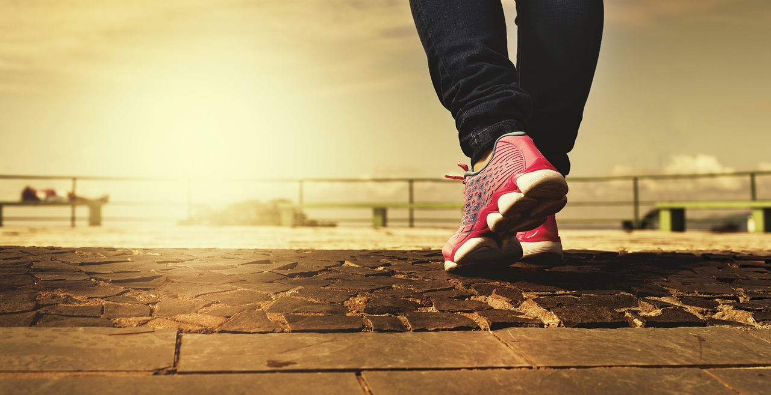
God,
please go with us.
Notes:
Slide 20:
As we start this new term together, and journey through the coming weeks, God, ‘please go with us’.

Slide 21
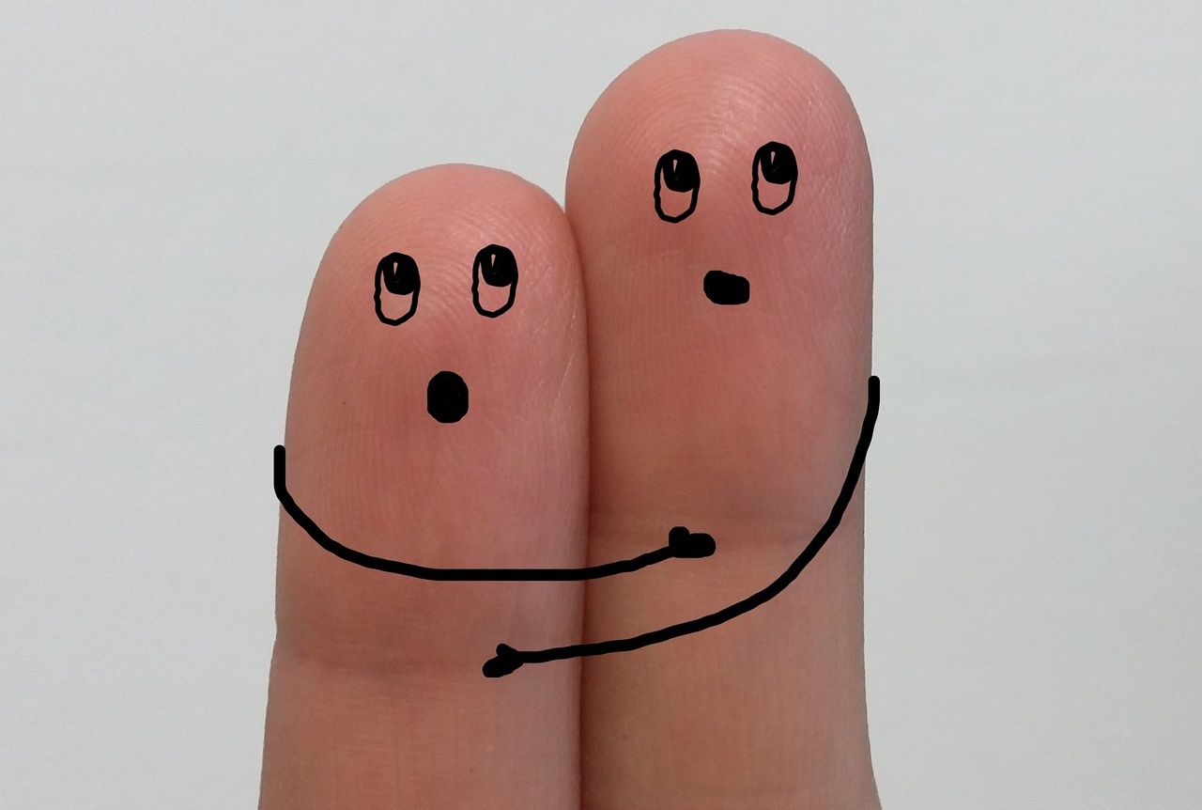
God,
please go with us.
Notes:
Slide 21:
We bring to our minds the people on the journey with us, God, ‘please go with us’.

Slide 22
God,
please go with us.
Notes:
Slide 22:
As we hear about Moses and journey along with him, God, ‘please go with us’.

Slide 23
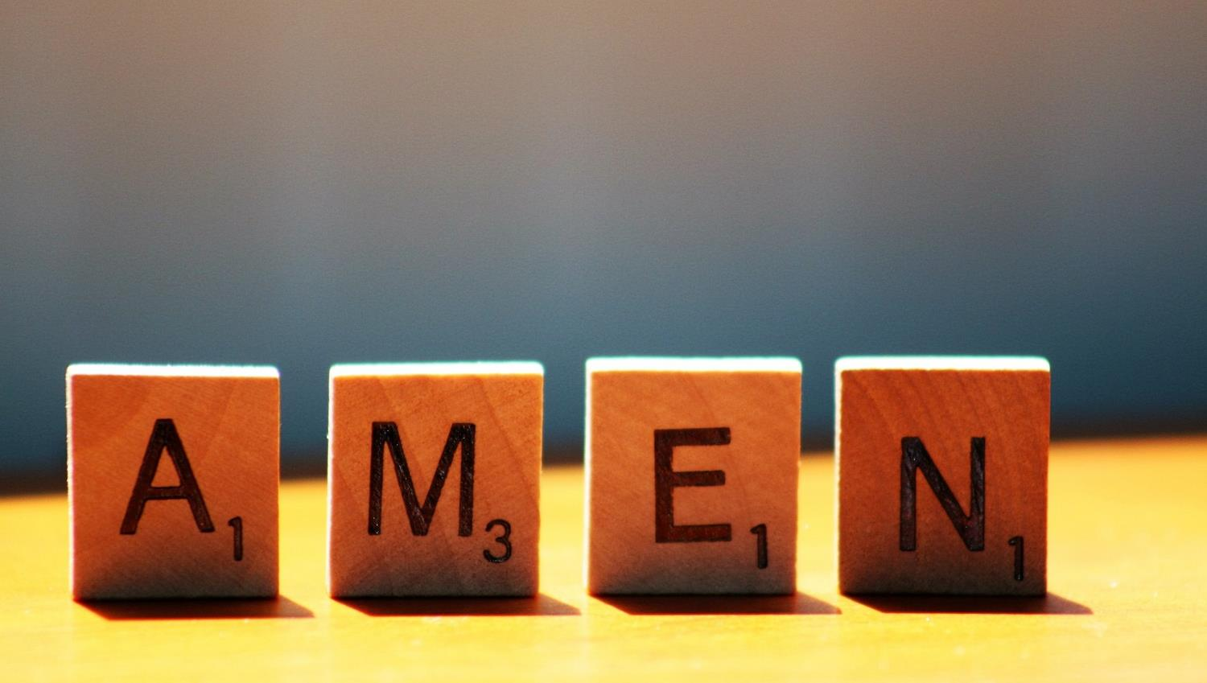

Slide 24
Leader: As we leave this place & time and go into the day ahead…
All: May today’s words help us to become a stronger community.

Slide 25
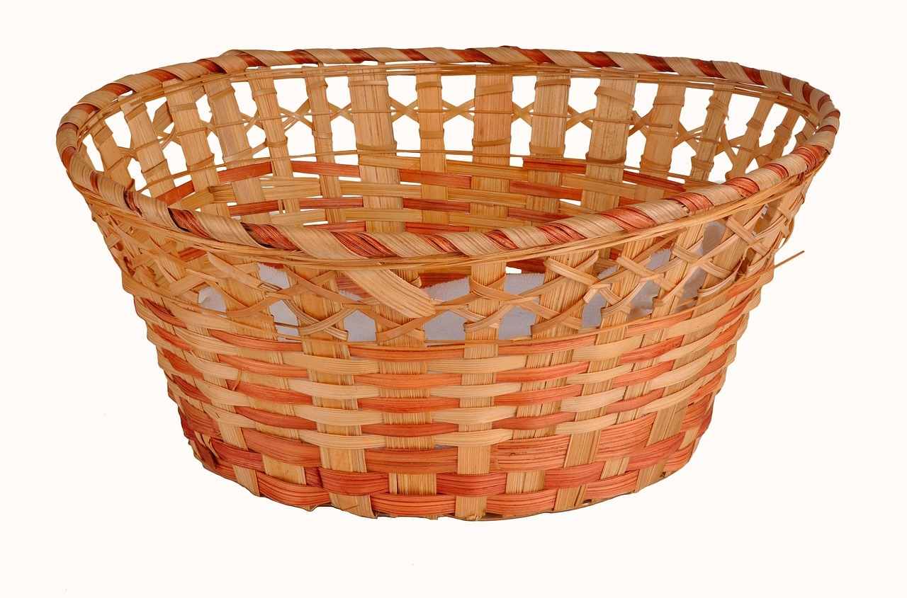
Notes:
Slide 23: Reflective prayer activity explanation

